Slide 1

Fake news detection

Slide 2
content
Introduction
Dataset and Data Cleaning
Tools
EDA
Topic Modeling
Recommendation
Notes:
Insert a picture illustrating a season in your country.

Slide 3
introduction
We consume news through several mediums throughout the day in our daily routine, but sometimes it becomes difficult to decide which one is fake and which one is authentic.
Do you trust all the news you consume from online media?
Notes:
Insert a picture of one of the geographic features of your country.

Slide 4
Dataset and data cleaning
The dataset has download from Kaggle website
It has 1000 rows
It is balanced
Tokenization
Stop words
Lemmatization

Slide 5
Tools
- Pandas - NMF
- Matplotlib - CountVectorizer, TfidfVectorizer
- Wordcloud - CorEx
- Sklearn - LSA
Notes:
Insert a map of your country.

Slide 6
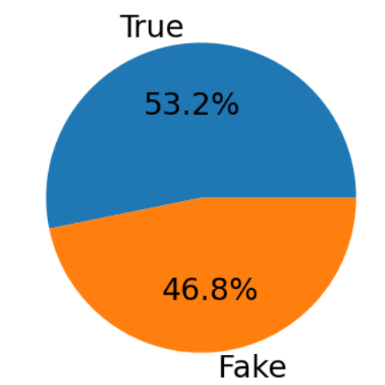
eda
The dataset has 532 true news and 468 fake news, which indicates that the dataset is balanced
Notes:
Insert a picture of an animal and or plant found in your country.

Slide 7
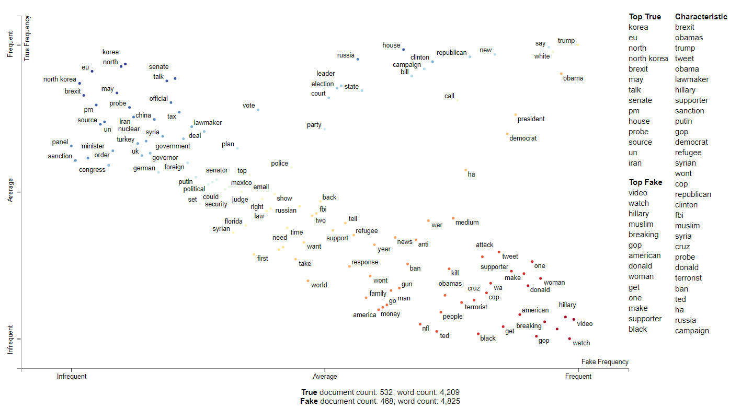
Eda

Slide 8
Topic modeling
Several topic modeling algorithms was tried, including:
LSA
CorEx
NMF (which is the best choice with 7 topics)
Notes:
Add key points in the history of your country to the timeline.

Slide 9
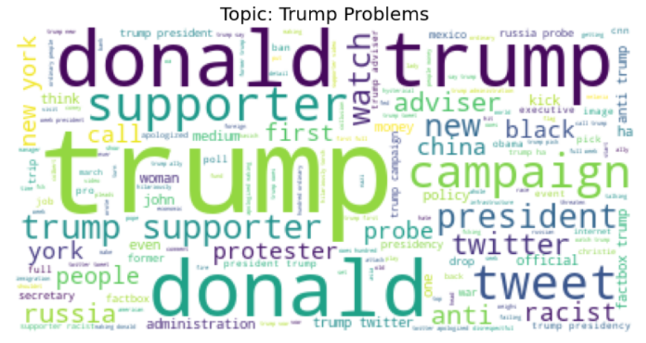
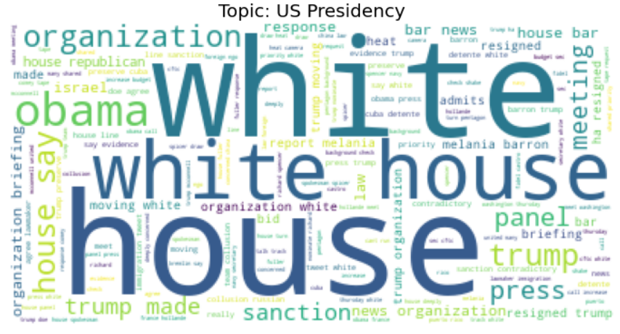
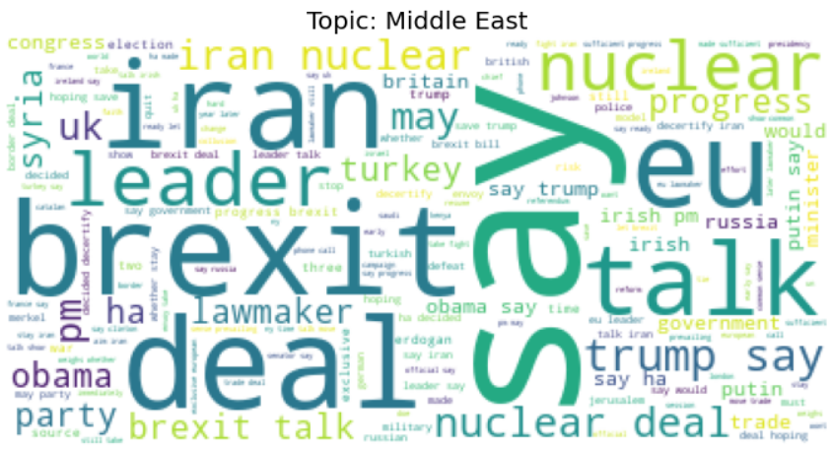
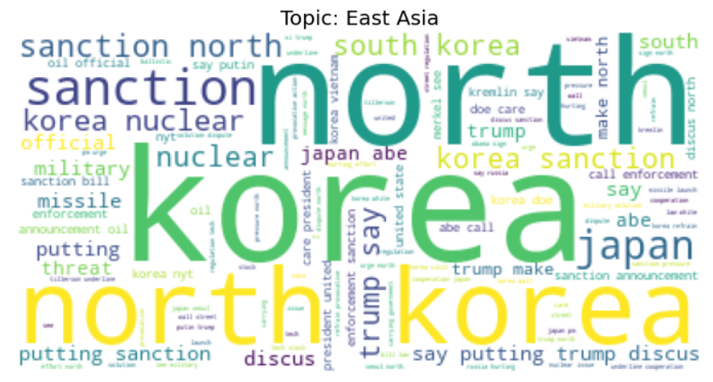
Topic modeling
Notes:
Insert a picture illustrating a custom or tradition here.

Slide 10
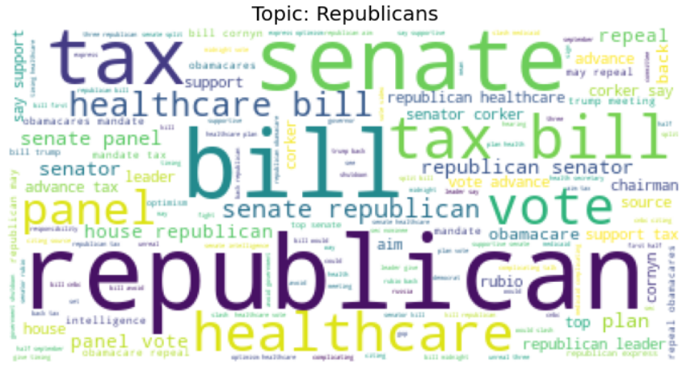
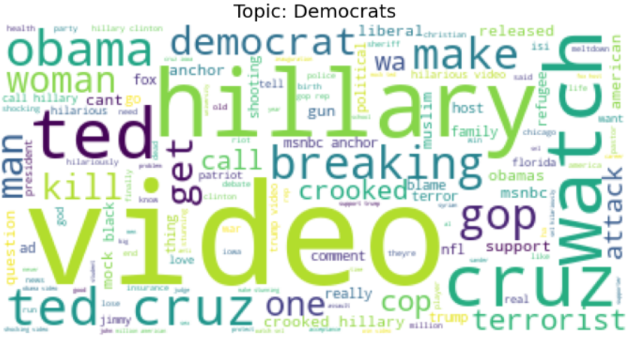
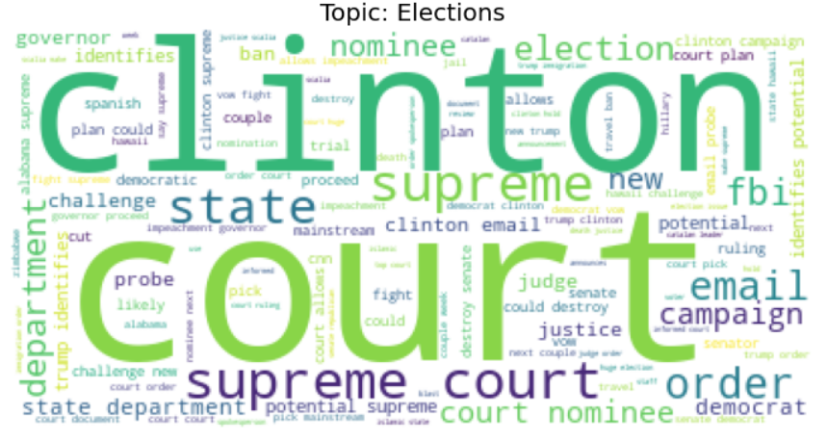
Topic modeling
Notes:
Insert a picture of the head leader of your country.

Slide 11
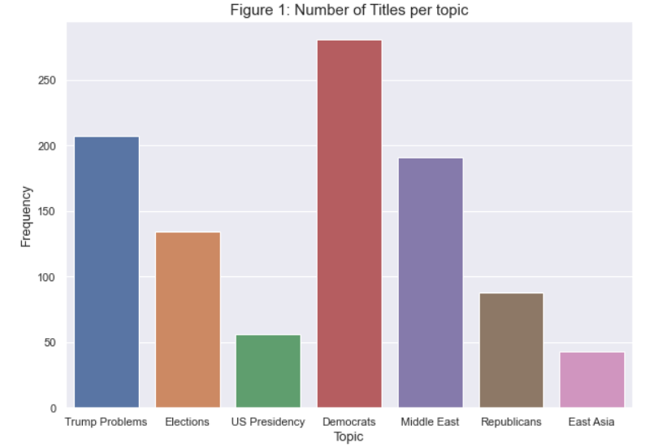
Topic modeling
Notes:
Insert a picture of one of the points of interest for your country.

Slide 12
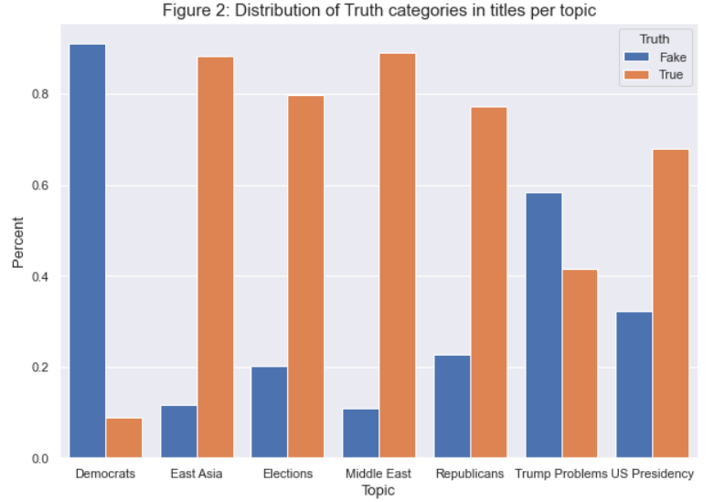
Topic modeling

Slide 13
Recommendation
There are multiple algorithms could be used in topic modeling
There is an overfitting when performing a classification model on the dataset because of lack of the rows
Notes:
Insert a picture that illustrates some part of your country’s economy.

Slide 14
Thank you

